Slide 1
MULTI-CUT REBAR(5)
Advisor : Prof. K.C.Chang
Presenters : You-Ran Nai

Slide 2
RIGOROUS
PROCEDURE
2
3
ETABS9
PYTHON
ETABS2016/SAP
MATLAB
IDA
ETABS DEMAND
MULTI-CUT
NONLINEAR HISTORY ANALYSIS
LINEAR
NON-LINEAR
1
4
EXCEL
VBA
ETABS9
PYTHON
MPA
MMC
APA
FROM EXISTING REBAR
MULTI-MODES PUSHOVER
ENGINEER
SIMPLICITY

Slide 3
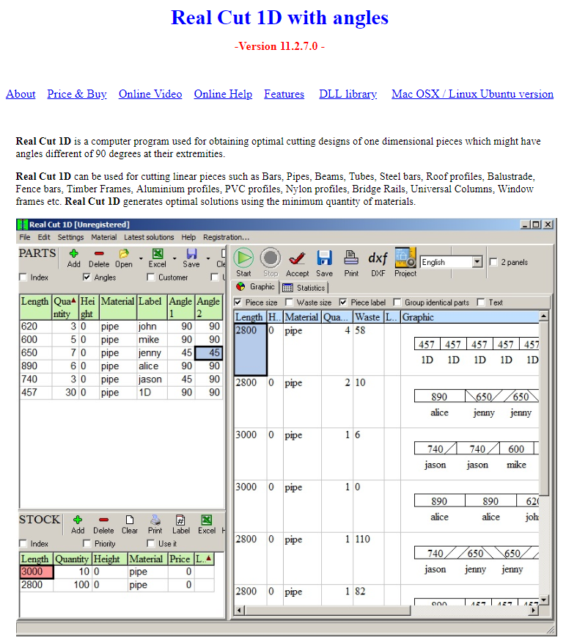
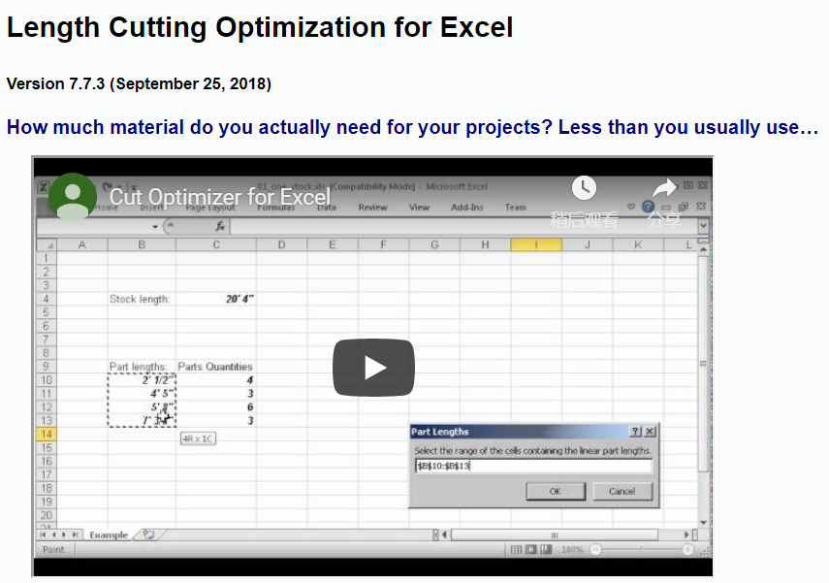
1D CUT

Slide 4
RIGOROUS
PROCEDURE
2
3
ETABS9
PYTHON
ETABS2016/SAP
MATLAB
IDA
ETABS DEMAND
MULTI-CUT
NONLINEAR HISTORY ANALYSIS
LINEAR
NON-LINEAR
1
4
EXCEL
VBA
ETABS9
PYTHON
MPA
MMC
APA
FROM EXISTING REBAR
MULTI-MODES PUSHOVER
ENGINEER
SIMPLICITY

Slide 5
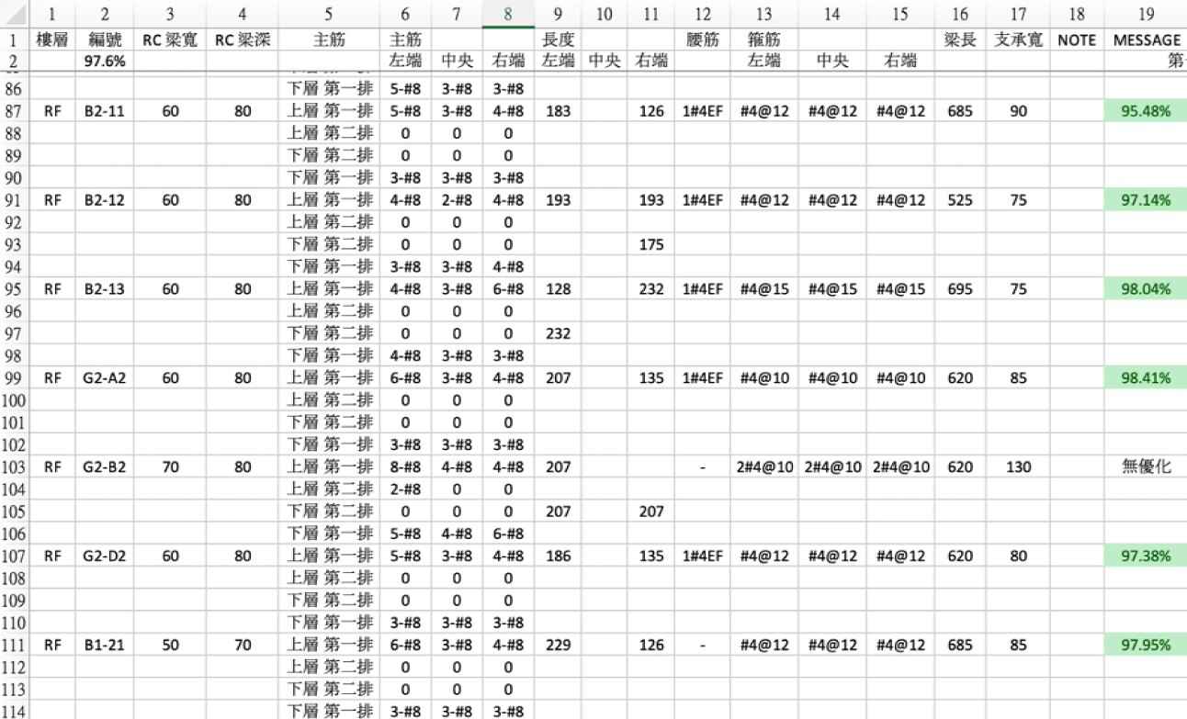
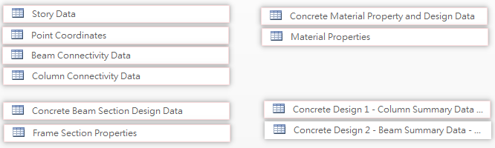
SOFTWARE ARCHITECTURE
INPUT
CONTROLLER
OUTPUT
GEOMETRY
MATERIAL
SECTION
DESIGN REBAR
SIZE
NUMBER
DEVELOPMENT LENGTH
- EXCEL

Slide 6
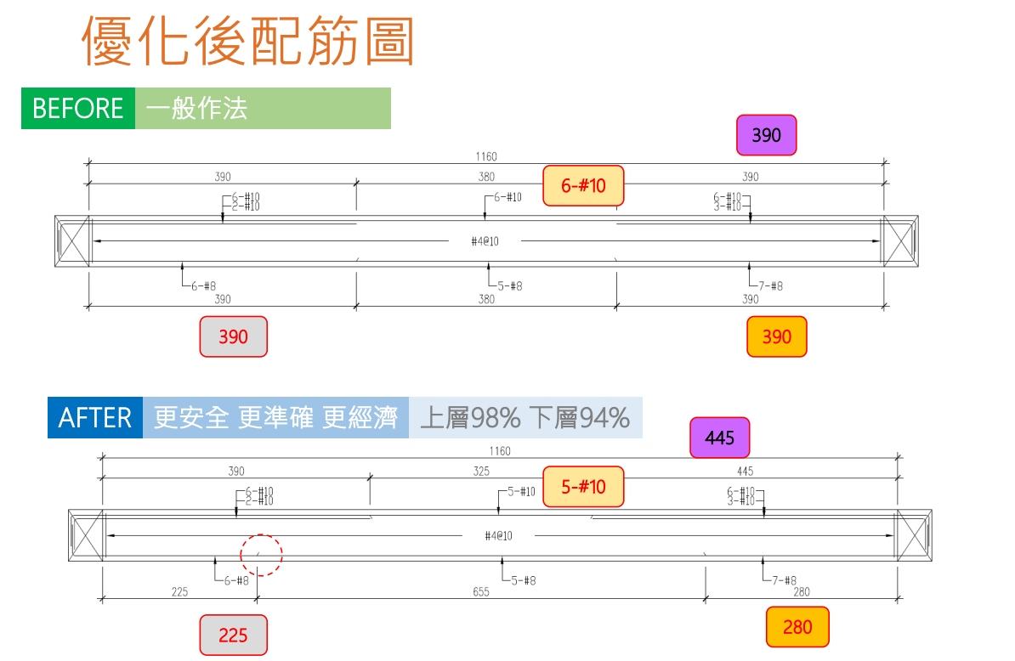
FINAL RESULT
GRAPH
REBAR SIZE & NUM
REBAR LENGTH
STIRRUP SIZE & S
B & D & L
SUPPORT WIDTH

Slide 7
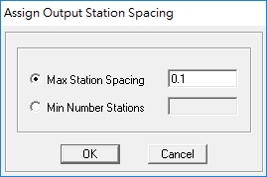
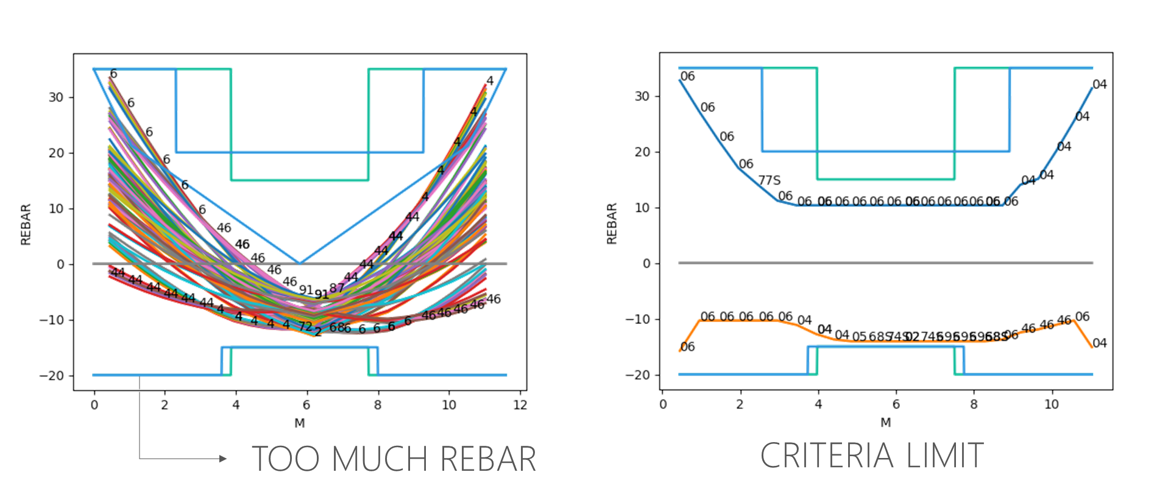
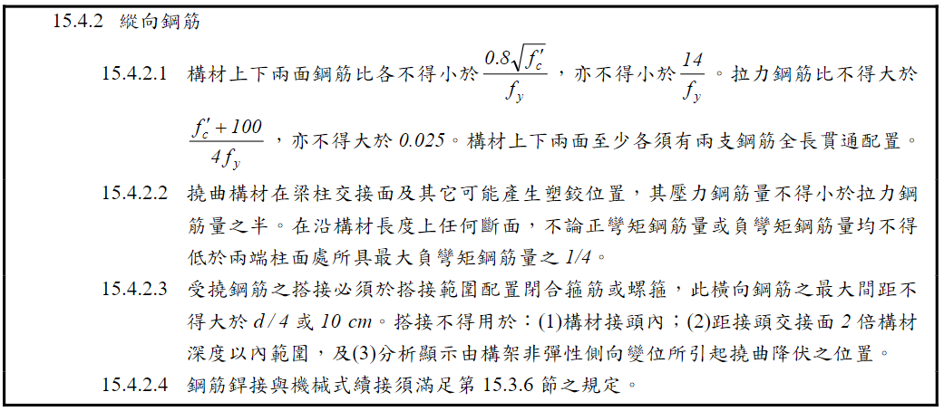
INPUT
2 MILLIONS
10 MILLIONS
30 THOUSANDS
GEOMETRY
MATERIAL
SECTION
BEAM FORCE
0.5 => 0.1
E2K
DESIGN REBAR
- ACI 318-05

Slide 8
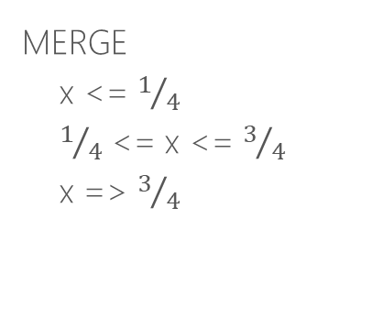
GRAPH
REBAR SIZE & NUM
REBAR LENGTH
STIRRUP SIZE & S
B & D & L
SUPPORT WIDTH
STIRRUP_REBAR = ['#4', '2#4', '2#5', '2#6']
STIRRUP_SPACING = [10, 12, 15, 18, 20, 25, 30]
first calc SIZE & S
groupby a beam
while spacing < MIN_SPACING
UPGRADE SIZE
MERGE
x <= $1/4$
$1/4$ <= x <= $3/4$
x => $3/4$
DROP DOUBLE SIZE

Slide 9
GRAPH
REBAR SIZE & NUM
REBAR LENGTH
STIRRUP SIZE & S
B & D & L
SUPPORT WIDTH
STIRRUP_REBAR = ['#4', '2#4', '2#5', '2#6']
STIRRUP_SPACING = [10, 12, 15, 18, 20, 25, 30]
HAVEN’T FINISH
first calc SIZE & S
groupby a beam
while spacing < MIN_SPACING
UPGRADE SIZE
MERGE
x <= $1/4$
$1/4$ <= x <= $3/4$
x => $3/4$
DROP DOUBLE SIZE

Slide 10
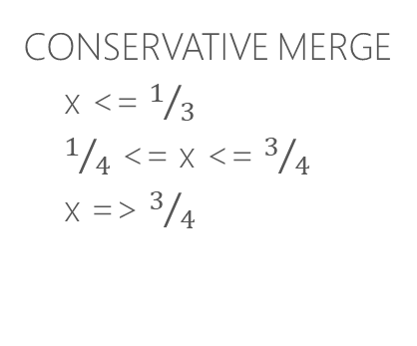
GRAPH
REBAR SIZE & NUM
REBAR LENGTH
STIRRUP SIZE & S
B & D & L
SUPPORT WIDTH
FIRST RUN
first calc SIZE & NUM
TOP_BAR = ['#7', '#8', '#10']
DB_SPACING = 1.5
groupby a beam
while num > 2 * capacity
UPGRADE SIZE
CONSERVATIVE MERGE
x <= $1/3$
$1/4$ <= x <= $3/4$
x => $3/4$

Slide 11
GRAPH
REBAR SIZE & NUM
REBAR LENGTH
STIRRUP SIZE & S
B & D & L
SUPPORT WIDTH
FIRST RUN
first calc SIZE & NUM
TOP_BAR = ['#7', '#8', '#10']
DB_SPACING = 1.5
groupby a beam
while num > 2 * capacity
UPGRADE SIZE
CONSERVATIVE MERGE
x <= $1/3$
$1/4$ <= x <= $3/4$
x => $3/4$
STRANGE
DIFFERENT FORM RCAD

Slide 12
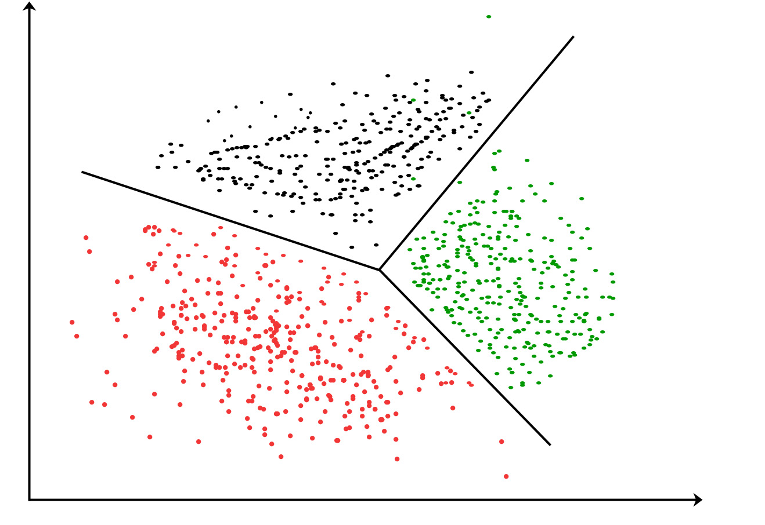
GRAPH
REBAR SIZE & NUM
REBAR LENGTH
STIRRUP SIZE & S
B & D & L
SUPPORT WIDTH
FIRST RUN
first calc SIZE & NUM
TOP_BAR = ['#7', '#8', '#10']
DB_SPACING = 1.5
groupby a beam
while num > 2 * capacity
UPGRADE SIZE
CONSERVATIVE MERGE
x <= $1/3$
$1/4$ <= x <= $3/4$
x => $3/4$
Calc Ld
OPTIMIZATION ALGORITHM

Slide 13
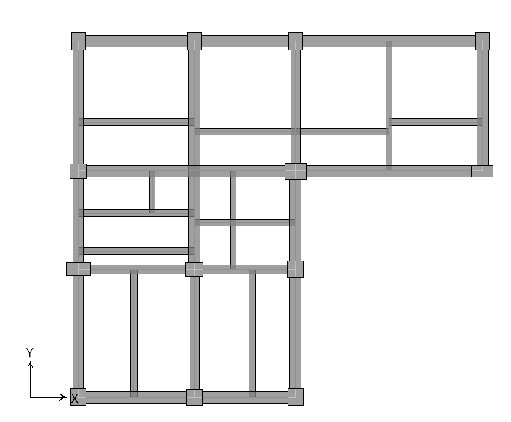
一台梁
SAME SIZE

Slide 14
GRAPH
REBAR SIZE & NUM
REBAR LENGTH
STIRRUP SIZE & S
B & D & L
SUPPORT WIDTH
FIRST RUN
SECOND RUN
first calc SIZE & NUM
groupby 一台梁
while any size < max size
calc max SIZE & NUM
groupby a beam
while num > 2 * capacity
UPGRADE SIZE
Calc Ld
CONSERVATIVE MERGE
x <= $1/3$
$1/4$ <= x <= $3/4$
x => $3/4$
OPTIMIZATION ALGORITHM
Calc Ld
OPTIMIZATION ALGORITHM

Slide 15
GRAPH
REBAR SIZE & NUM
REBAR LENGTH
STIRRUP SIZE & S
B & D & L
SUPPORT WIDTH
FIRST RUN
SECOND RUN
first calc SIZE & NUM
groupby 一台梁
while any size < max size
calc max SIZE & NUM
groupby a beam
while num > 2 * capacity
UPGRADE SIZE
Calc Ld
CONSERVATIVE MERGE
x <= $1/3$
$1/4$ <= x <= $3/4$
x => $3/4$
OPTIMIZATION ALGORITHM
Calc Ld
HAVEN’T FINISH
OPTIMIZATION ALGORITHM

Slide 16
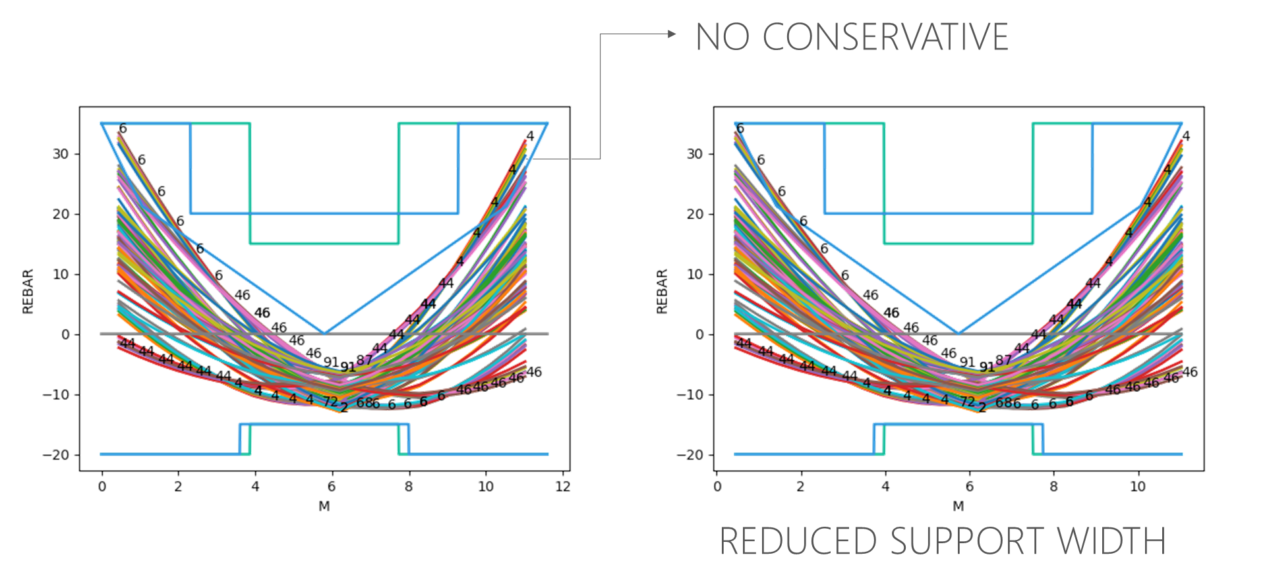
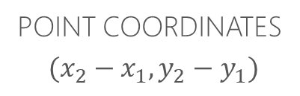
GRAPH
REBAR SIZE & NUM
REBAR LENGTH
STIRRUP SIZE & S
B & D & L
SUPPORT WIDTH
POINT COORDINATES
$(x_{2}−x_{1}, y_{2}−y_{1})$
CONCRETE SECTIONS
MIN
梁長 - MAX

Slide 17
Roadmap
SECOND
FOURTH
SIXTH
剪力
雙箍轉單箍
彎矩多點斷筋 - 4 5 點
剪力多點斷筋
FIRST
THIRD
FIFTH
彎矩多點斷筋 - 3 點
RCAD 比較
自動識別幾何

Slide 18
A modal pushover analysis procedure to estimate seismic demands for unsymmetric-plan buildings
Anil K. Chopra and Rakesh K. Goel
EARTHQUAKE ENGINEERING AND STRUCTURAL DYNAMICS
November 2003

Slide 19
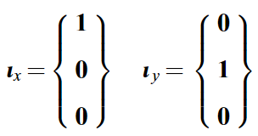

EQUATIONS OF MOTION

Slide 20
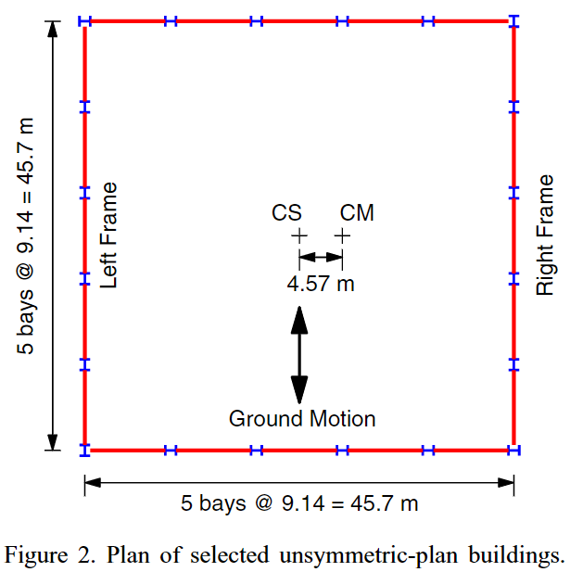
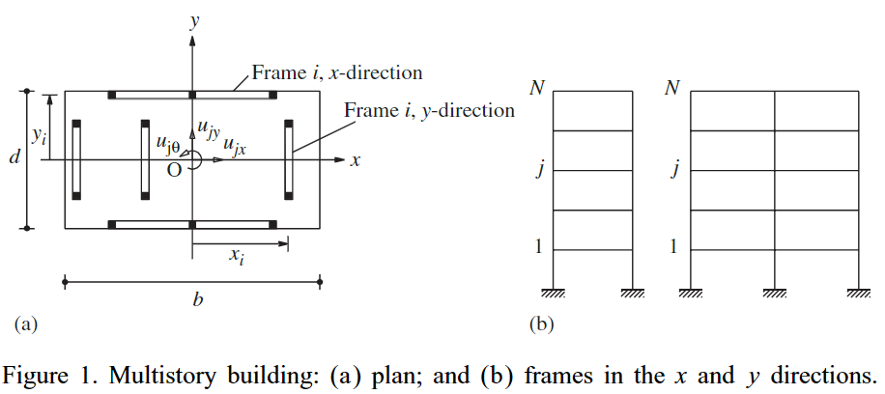
SELECTED BUILDINGS

Slide 21
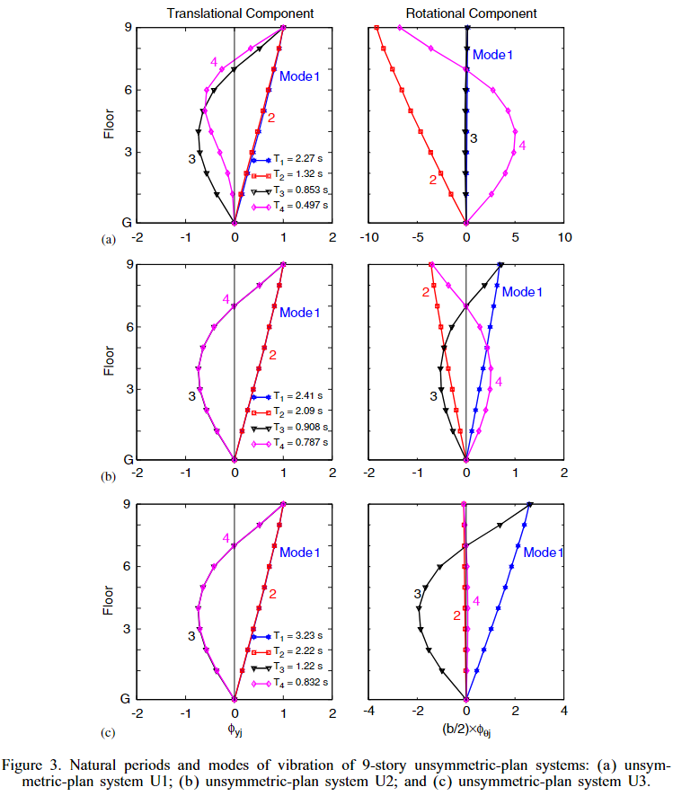




TORSIONALLY-STIFF
$$I_{Oj}/m$$
LATERAL > TORSIONAL
TORSIONALLY-SIMILARLY-STIFF
FIRST TWO MODES CLOSE
$I_{Oj}/m$ = 2.95
LATERAL $≅$ TORSIONAL
TORSIONALLY-FLEXIBLE
$I_{Oj}/m$ = 6
LATERAL < TORSIONAL

Slide 22
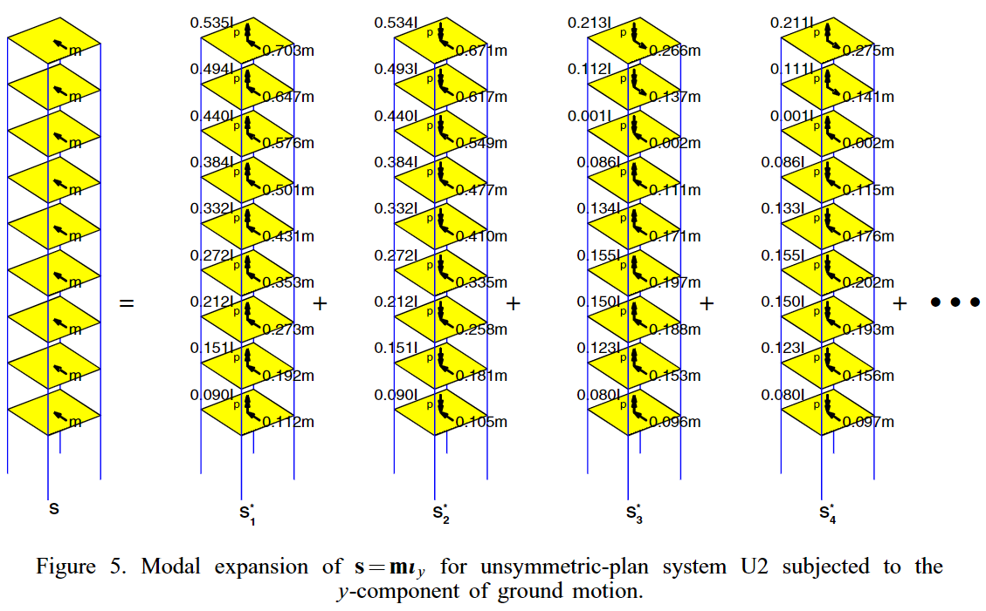



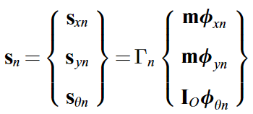
MODAL EXPANSION OF EFFECTIVE FORCES

Slide 23
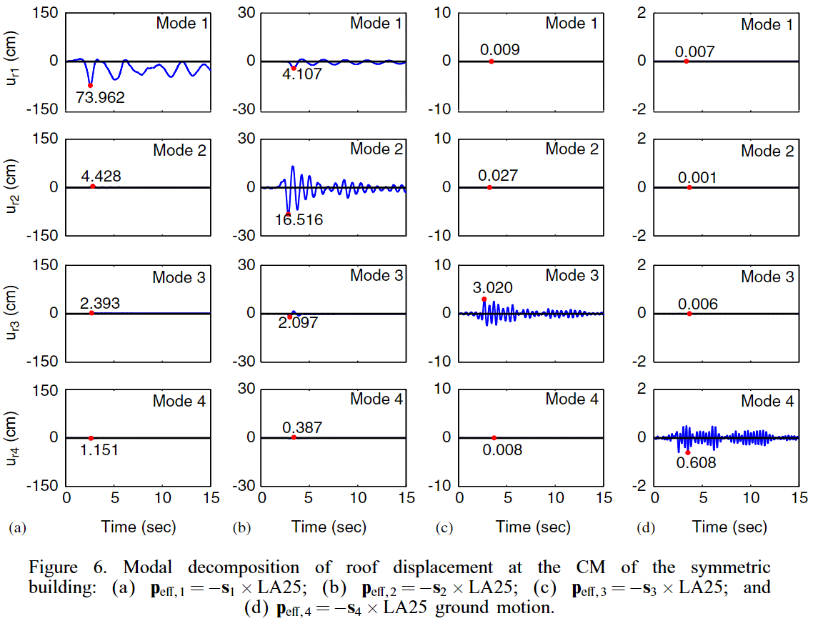
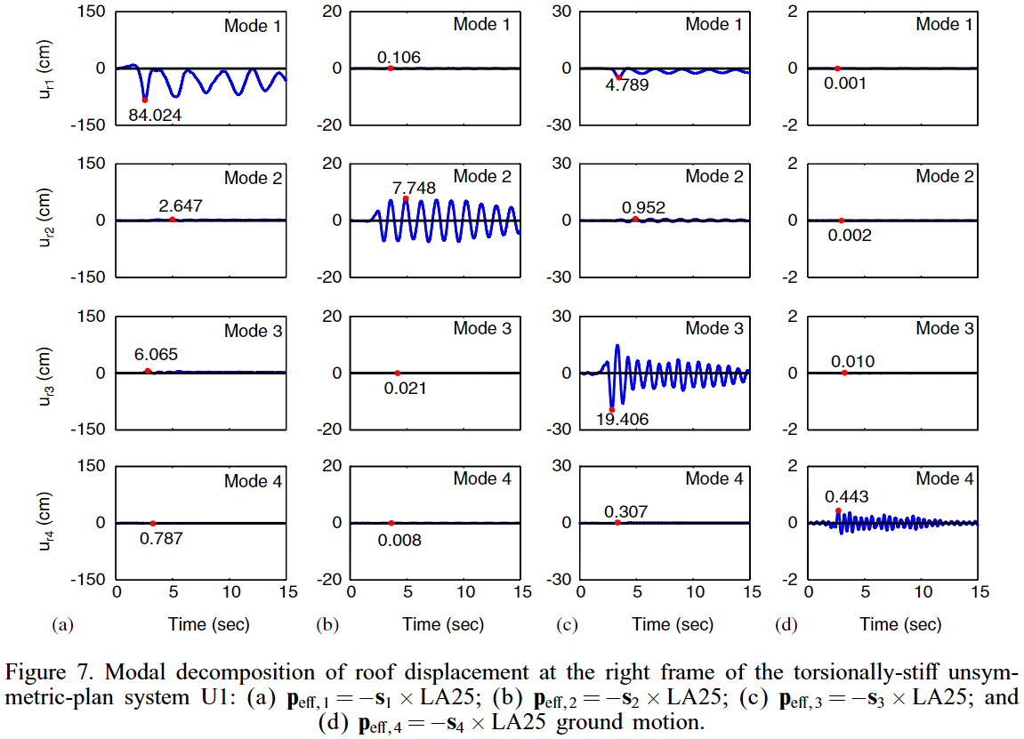


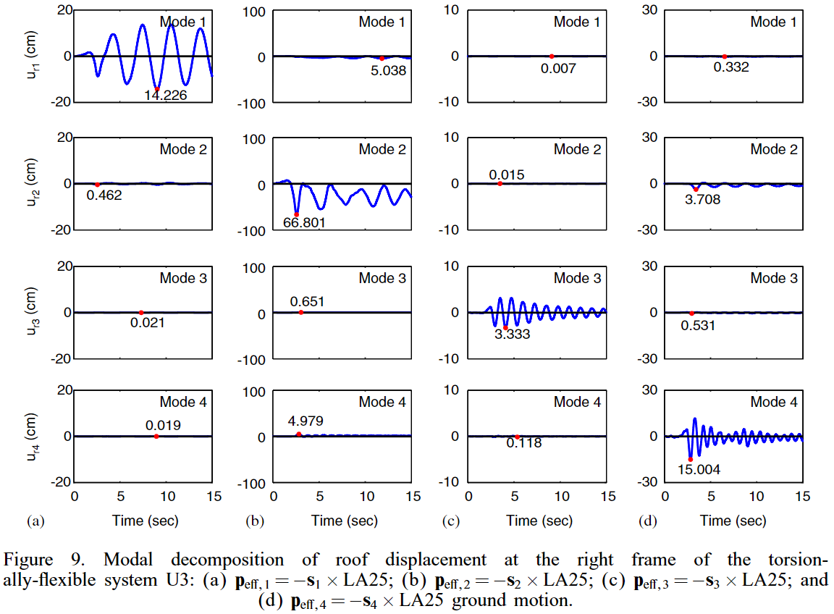
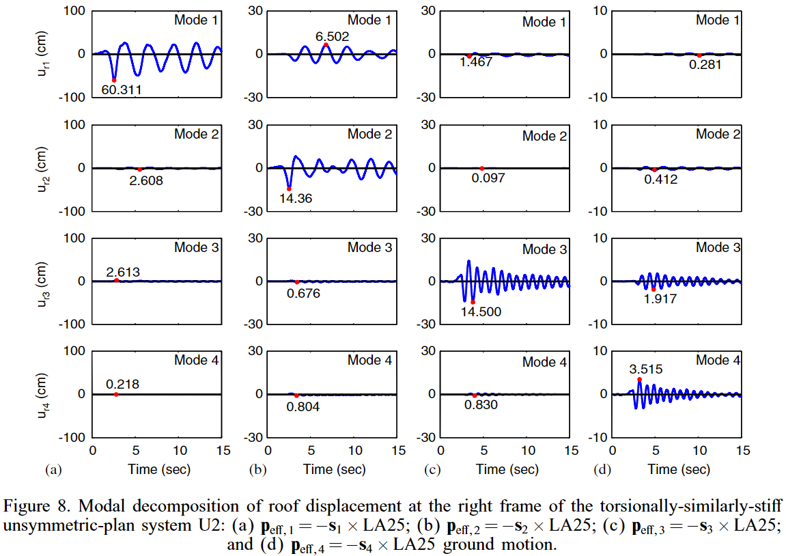
SYMMETRIC
TORSIONALLY-STIFF
TORSIONALLY-FLEXIBLE
TORSIONALLY-SIMILARLY-STIFF

Slide 24
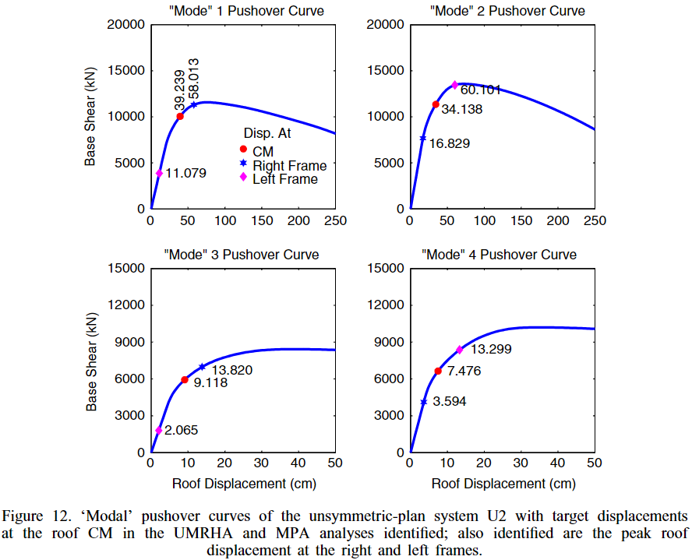
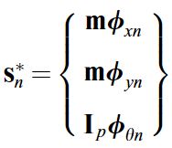
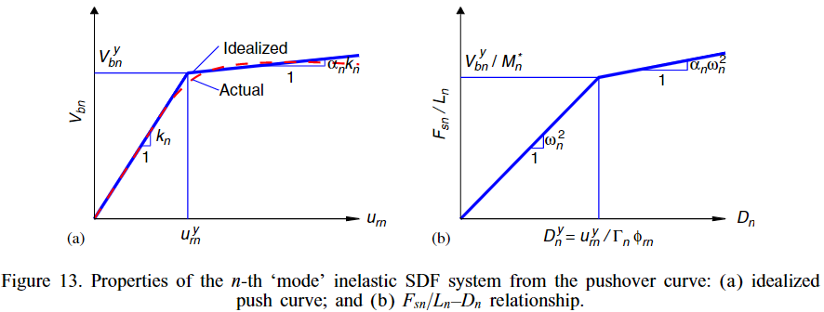
MPA
MODAL FORCE DISTRIBUTION
MODAL COMBINATION RULE
CQC

Slide 25
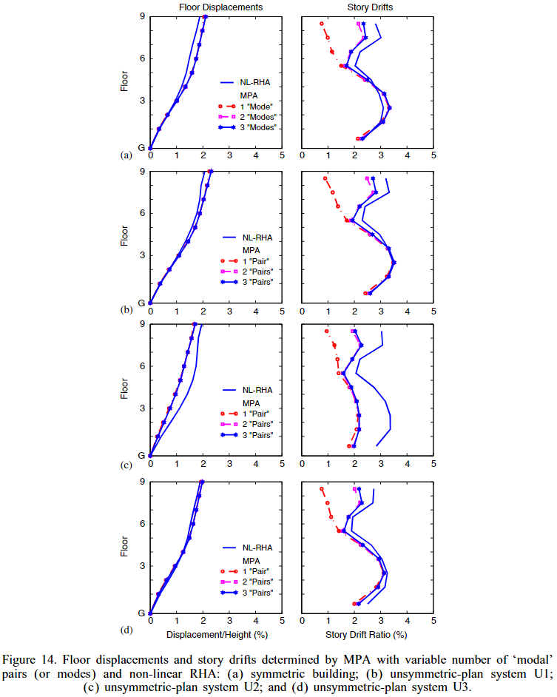
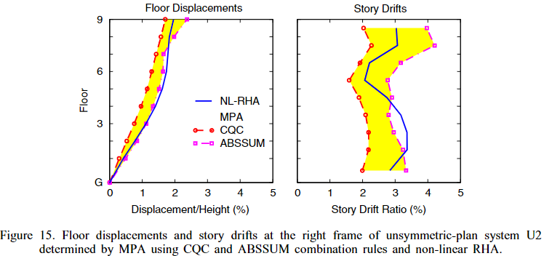
SYMMETRIC
U1
U2
CQC UNDER-ESTIMATION
U3

